Slide 1
Travelling Salesman Problem
Sebastian Dittmann
COSC 6111
Advanced Design and Analysis of Algorithms

Slide 2
Structure
Definition
Applications
Complexity
Triangle TSP
State-of-the-art
TSP-History
Conclusion

Slide 3
Definition I
Important NPC Problem
Travelling Salesman Problem (TSP)
  Given n cities and the costs of travelling from one city to another.
  Find the shortest tour that visits all cities exactly once and then returns to the starting city.

Slide 4
Definition II
Travelling Salesman Problem (TSP)
  Given a weighted undirected complete graph with n nodes.
  Starting at node s find a cycle that visits each node exactly once and ends in s (Hamiltonian cycle) with the least weight.

Slide 5
Example
B
3
A
8
2
2
2
C
4
E

Slide 6
Example
B
3
A
8
2
2
2
C
4
E
Cost of optimal tour = 11

Slide 7
Applications
Travelling person selling products
Robots drilling holes
Logistic
Art
Development and testing of optimization algorithms

Slide 8
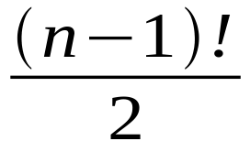
Complexity I
Determine all possible cycles
# of Hamiltonian cycles in complete graph :
Find the shortest cycle
→ O (n!)
Notes:
factorial

Slide 9
Complexity II
Dynamic Programming
Compare “Shortest Weighted Path” algorithm in class
Pass subinstance of TSP to your friend
→ O (n²2^{n})
“Improvement”: n! >> n²2^{n}
Approximative algorithm is needed
Notes:
factorial
Approach = Ansatz

Slide 10
Triangle TSP I
Graph obeys the triangle inequality:
∀u,v,w ∈ V : d(u,w) ≤ d(u,v) + d(v,w)
Example:
d(A,C) ≤ d(A,B) + d(B,C)
B
2
2
A
C
3

Slide 11
Triangle TSP II
Triangle TSP (TTSP) ∈ NPC
Most natural instances of TSP satisfy this constraint
TTSP is constant factor approximative (TSP isn’t, else P=NP)
∃algorithm A: A(TTSP) ≤ c * OPT (TTSP)

Slide 12
2-approximative
algorithm 2approx(G)
G’ = MST (G)
G’’ = G’ with every edge doubled
G’’’ = EulerTour(G’’)
return (removeDuplicates(G’’’)
end algorithm
MST(G) ≤ 2approx(G) ≤ 2 * OPT (G)

Slide 13
Example
B
3
A
8
2
2
2
C
4
E

Slide 14
Example
B
3
A
8
2
2
2
C
4
E
Cost of optimal tour = 11

Slide 15
Example
B
3
A
8
2
2
2
C
4
E
Cost of MST = 6

Slide 16
Example
B
3
A
8
2
2
2
C
4
E
Cost of EulerTour = 12

Slide 17
Example
B
3
A
8
2
2
2
C
4
E
Cost of tour = 14 ≤ 22 = 2 * OPT (G)

Slide 18
1.5-approximative
algorithm christofides(G)
G’ = MST (G)
G’’ = G’ + perfectMatching( G’_odd degree)
G’’’ = EulerTour(G’’)
return (removeDuplicates(G’’’)
end algorithm
MST(G) ≤ christofides(G) ≤ 1.5 * OPT (G)

Slide 19
Example
B
3
A
8
2
2
2
C
4
E

Slide 20
Example
B
3
A
8
2
2
2
C
4
E
Cost of optimal tour = 11

Slide 21
Example
B
3
A
8
2
2
2
C
4
E
Cost of MST = 6

Slide 22
Example
B
3
A
8
2
2
2
C
4
E
Cost of tour = 14 ≤ 16.5 = 1.5 * OPT (G)

Slide 23
State-of-the-art
Christofides (1975) is best known heuristic with constant efficiency
Common TSP-algorithm use
  nearest neighbor,
  branch & bound,
  branch & bound & cut,
  linear programming

Slide 24
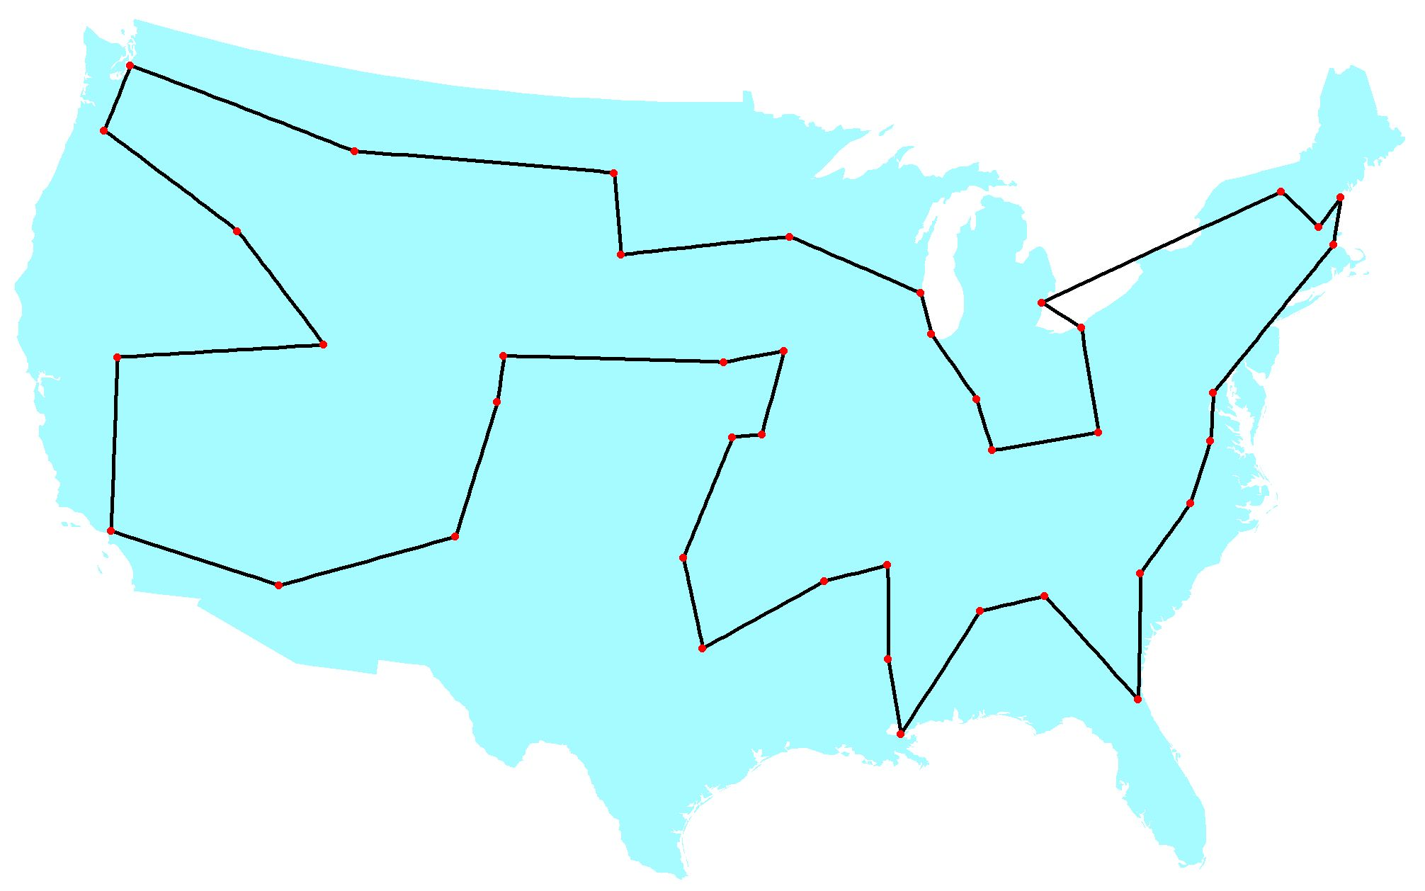
History
1954 – 49 cities – 6* 10⁶⁰ cycles

Slide 25
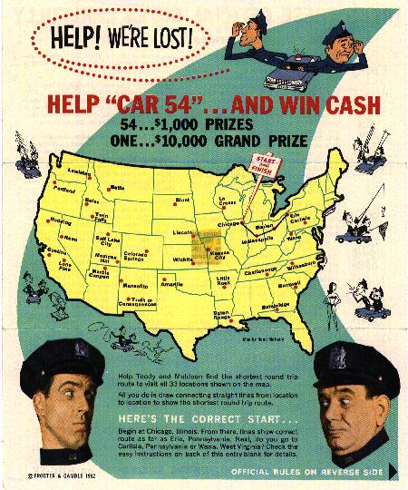
History
1962
33 cities
1.3 * 10³⁵ cycles
Contest from Procter & Gamble
Notes:
Procter Gamble

Slide 26
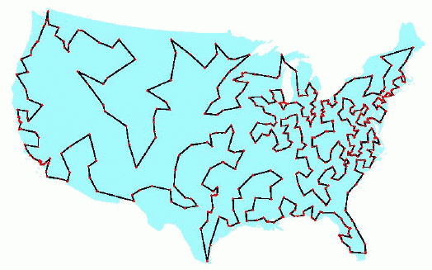
History
1987 – 532 cities – 7.5* 10¹²¹⁷ cycles

Slide 27
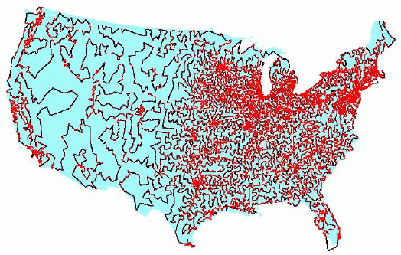
History
1998 – 13,509 cities – 5.5*10^{49,931} cycles

Slide 28
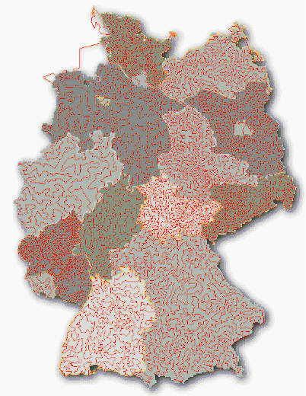
History
2001
15,112 cities
MANY cycles
22 CPU years
Cologne

Slide 29
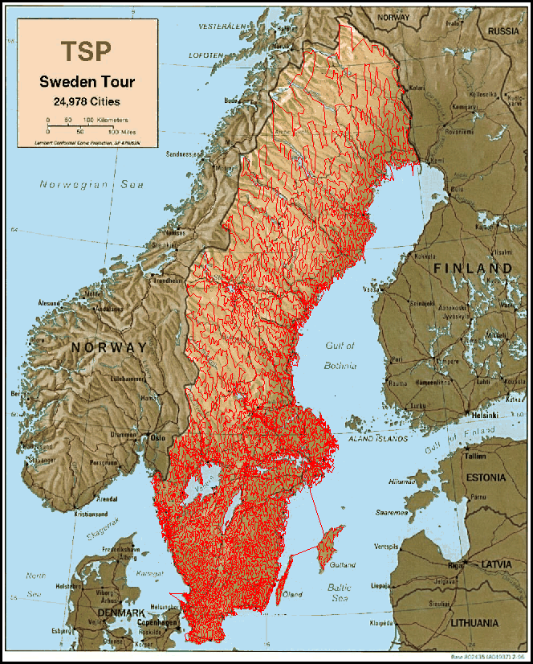
History
2004
24,978 cities
MANY² cycles
85 CPU years

Slide 30
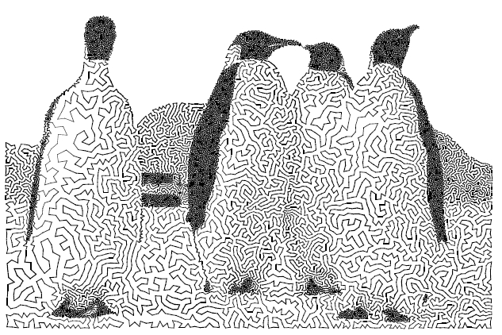
TSP-Art

Slide 31
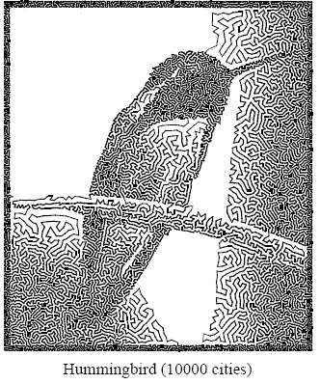
TSP-Art

Slide 32
Conclusion
TSP important NPC-problem
n! number of possible solutions
Triangle TSP is constant factor approximative (1.5)
TSP with 24,978 cities solved
Notes:
factorial

Slide 33
References
www.tsp.gatech.edu/index.html
www.inf.fh-brs.de/Witt
www.cgl.uwaterloo.ca/~csk/projects/tsp
http://www.cs.ubc.ca/labs/beta/Courses/CPSC532D-05/Slides/tsp-camilo.pdf

Slide 34

Questions

